Slide 1
Dividing a whole number by a fraction
Arithmetic procedures with fractions

Slide 2
how to use Oak lessons

Slide 3
I can use the mathematical structures that underpin the division of fractions to divide a whole number by a fraction.

Slide 4
A proper fraction is a fraction where the numerator is less than the denominator.
Unitising means treating groups that contain, or represent, the same numbers of things as ‘ones’ or ‘units’.

Slide 5

Dividing a whole number by a fraction
Making sense of dividing by a fraction
Deepening understanding of dividing by a fraction

Slide 6
Making sense of dividing by a fraction
Division can also be written in different ways.
Example:
What different ways can 8 ÷ 2 be written?
8 shared by 2
The line indicates division
8 grouped into 2s

Slide 7
Making sense of dividing by a fraction
How many times does 5 fit into 20?
20
5 | 5 | 5 | 5

Slide 8

Making sense of dividing by a fraction
We have 4 units
The 5 is the counting unit.
20
5 | 5 | 5 | 5
unit | unit | unit | unit

Slide 9
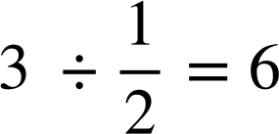

Making sense of dividing by a fraction
This approach can help us to represent division by fractions.
For example,
We have 6 units
The
is the unit.
1 | 1 | 1
unit
unit
unit
unit
unit
unit

Slide 10
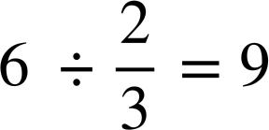

Making sense of dividing by a fraction
Example,
9
lots
of
fit into 6
How
many
fit?
1 | 1 | 1 | 1 | 1 | 1

Slide 11
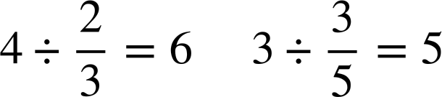


Making sense of dividing by a fraction
Work out the answer to
You can use a bar model to help.
Work out the answer to
You can use a bar model to help.
1 | 1 | 1 | 1
1 | 1 | 1

Slide 12
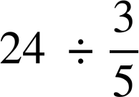
Making sense of dividing by a fraction
Using bar models is a good way to see how the division by fractions works. However, if we get bigger numbers it becomes difficult with bar models.
For example,
We can quickly work out division by fractions without too.

Slide 13
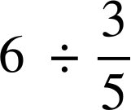
Making sense of dividing by a fraction
We will look at another example to try to find an efficient method.
1 | 1 | 1 | 1 | 1 | 1
6
Showing the fifths:
There are 30
How many fifths are there?
How can you identify how many fifths you have in the whole number without drawing the bar model?
Multiply the denominator of the divisor by the whole number.

Slide 14


Making sense of dividing by a fraction
We will look at another example to try to find an efficient method.
1 | 1 | 1 | 1 | 1 | 1
6 × 5 = 30, so we have

Slide 15
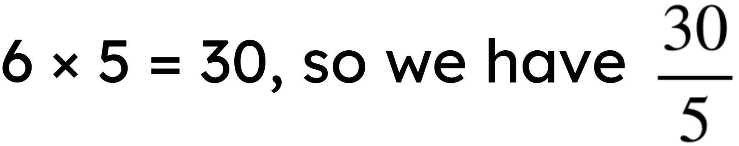
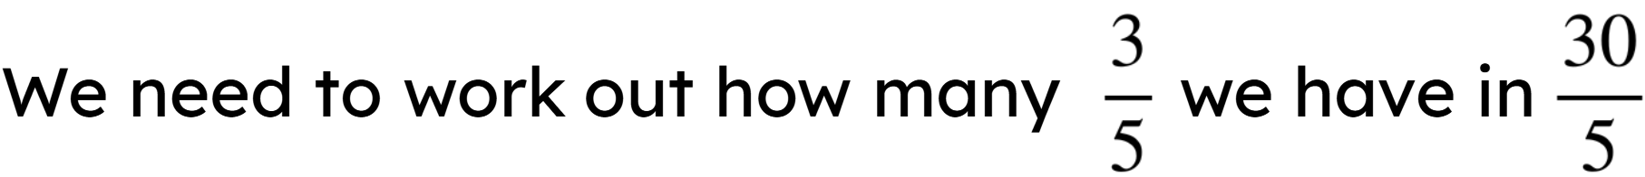
Making sense of dividing by a fraction
We will look at another example to try to find an efficient method.
1 | 1 | 1 | 1 | 1 | 1

Slide 16
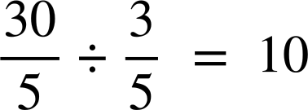
Making sense of dividing by a fraction
We will look at another example to try to find an efficient method.
1 | 1 | 1 | 1 | 1 | 1
6 × 5 = 30, so we have

Slide 17
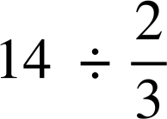

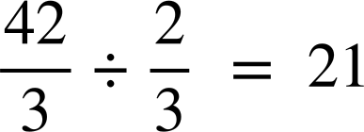
Making sense of dividing by a fraction
So, to work out this calculation efficiently:
14 × 3 = 42, so we have

Slide 18
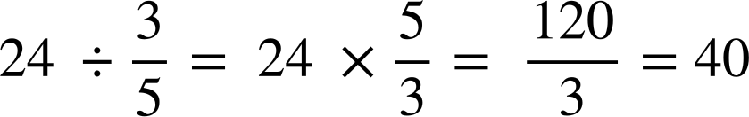
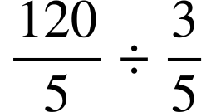
Making sense of dividing by a fraction
Work out the answer to

Slide 19
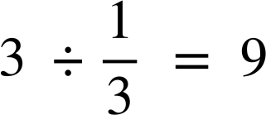
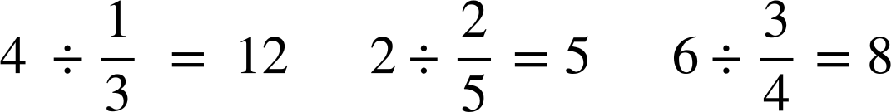
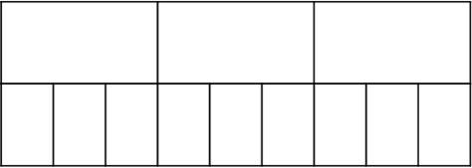
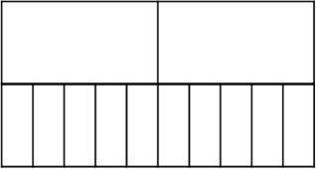
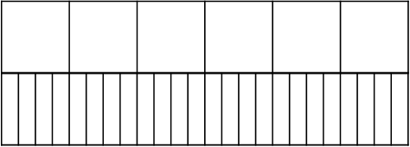
Making sense of dividing by a fraction
Use the bar models to show the division of the following:
a)
b)
c)

Slide 20
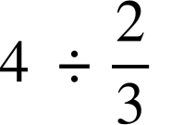
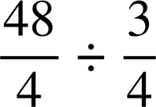

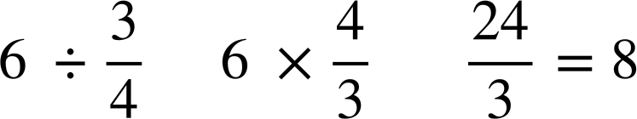
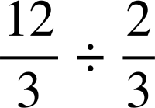
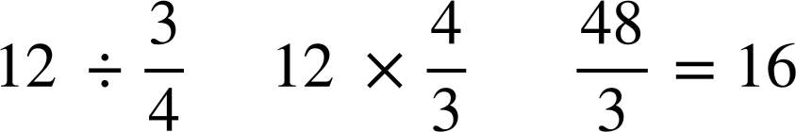
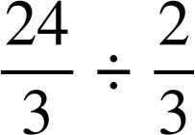
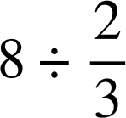
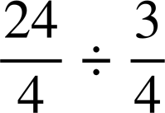
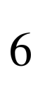
Making sense of dividing by a fraction
2) Match the question with the calculation and the answer.

Slide 21
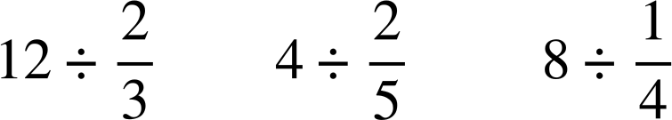
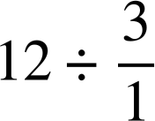
Making sense of dividing by a fraction
3) Circle the following divisions which give an answer of four.

Slide 22
Making sense of dividing by a fraction
4) Put the following in ascending order, smallest to largest.
5) Create three of your own questions which, when dividing an integer by a proper fraction, give the answer of 10.

Slide 23

Making sense of dividing by a fraction
Use the bar models to show the division of the following:
a)
b)
c)
1 | 1 | 1
1 | 1
1 | 1 | 1 | 1 | 1 | 1
U
U
U
U
U
U
U
U
U
U
U
U
U

Slide 24
Making sense of dividing by a fraction
2) Match the question with the calculation and the answer.

Slide 25
Making sense of dividing by a fraction
3) Circle the following divisions which give an answer of four.

Slide 26
Making sense of dividing by a fraction
4) Put the following in ascending order, smallest to largest.

Slide 27
Dividing a whole number by a fraction
Making sense of dividing by a fraction
Deepening understanding of dividing by a fraction

Slide 28
Deepening understanding of dividing by a fraction
Not every division by a fraction will give an integer answer. So let’s look at when the the fraction does not fit a whole number of times using our bar models.

Slide 29
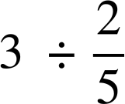
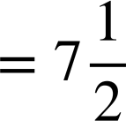
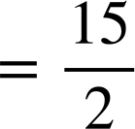
Deepening understanding of dividing by a fraction
For example,
1 | 1 | 1
unit
unit
unit
unit
unit
unit
unit
unit
7 full units
½ a unit

Slide 30
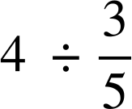
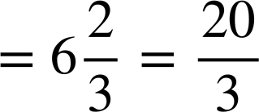
Deepening understanding of dividing by a fraction
Using the bar model, can you identify the answer to
1 | 1 | 1 | 1
unit
unit
unit
unit
unit
unit
unit
6 full units
⅔ of a unit

Slide 31
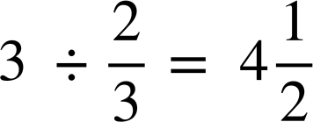
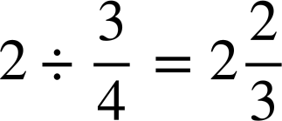
Deepening understanding of dividing by a fraction
Using the below bar model, work out the answer to the following
Using the below bar model, work out the answer to the following
1 | 1 | 1
1 | 1
unit
unit
unit
unit
unit
unit
unit
unit

Slide 32
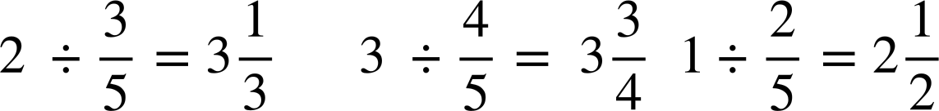
Deepening understanding of dividing by a fraction
1 | 1
Using the bar models, work out the answers to the following:
a)
1 | 1 | 1
b)
1
c)

Slide 33
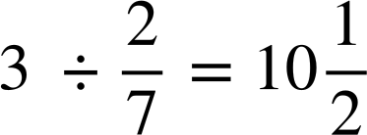
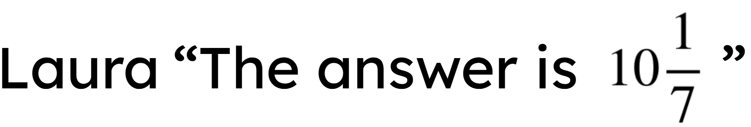
Deepening understanding of dividing by a fraction
Izzy “The answer is 9”
2) Izzy and Laura have done the following bar models for a question
Both have made an error with their bar model.
Explain where they have made their mistake.
Amend a bar model to help work out the correct answer.
U
U
U
U
U
U
U
U
U
U
U
U
U
U
U
U
U
U
U

Slide 34
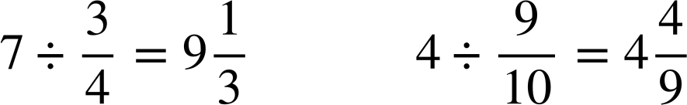
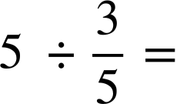
Deepening understanding of dividing by a fraction
3) Using squared paper, draw your own bar models to work out the answers to
a)
b)
c)

Slide 35
Deepening understanding of dividing by a fraction
1 | 1
Using the bar models, work out the answers to the following:
a)
unit
unit
unit
unit
1 | 1 | 1
b)
unit
unit
unit
unit
1
c)
unit
unit
unit

Slide 36
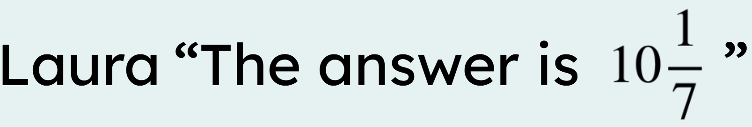
Deepening understanding of dividing by a fraction
Izzy “The answer is 9”
2) Izzy and Laura have done the following bar models for a question
Both have made an error with their bar model.
Explain where they have made their mistake.
Amend a bar model to help work out the correct answer.
U
U
U
U
U
U
U
U
U
U
U
U
U
U
U
U
U
U
U

Slide 37
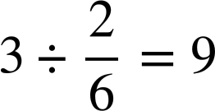
Deepening understanding of dividing by a fraction
Izzy “The answer is 9”
2) Explain where they have made their mistake for the question
U
U
U
U
U
U
U
U
U
Izzy has divided each 1 into sixths rather than sevenths.
Izzy has calculated

Slide 38

Deepening understanding of dividing by a fraction
2) Explain where they have made their mistake for the question
Laura started to correctly use a
unit to be , but then
incorrectly changed the unit to
be .
U
U
U
U
U
U
U
U
U
U

Slide 39
Deepening understanding of dividing by a fraction
Izzy “The answer is 9”
Amend a bar model to help work out the correct answer.
U
U
U
U
U
U
U
U
U
Changing Laura’s so there is a consistency of units, the answer is seen to be
U
U
U
U
U
U
U
U
U
U

Slide 40
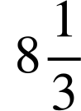
Deepening understanding of dividing by a fraction
3) Using squared paper, draw your own bar models to work out the answers to
a)
b)
c)
U
U
U
U
U
U
U
U
U
U
U
U
U
U
U
U
U
U
U
U
U
U
U
U
U
U
U

Slide 41
Dividing a whole number by a fraction
Using bar models is a good way to see how the division by fractions works.
Unitising means treating groups that contain, or represent, the same numbers of things as ‘ones’ or ‘units’.
Using the unitising method alongside bar models helps deepen the understanding of how we get the answer when dividing a whole number by a fraction.

Slide 42

© Oak National Academy 2023.
Produced in partnership with Mathematics in Education and Industry.
Licensed on the Open Government Licence v3.0, except where otherwise stated. See Oak terms and conditions.

